Slide 1
An intoduction to the Auto-scrutineer
Contents
New submission folder structure
Basic overview
Rule types
Explanation and examples
In-depth overview (wip)
Rule definitions (wip)
VTK-pipelines (wip)
Part 1
Relevant to everyone
Part 2
Mostly relevant to staff and maintainers
(but everyone is welcome)
Disclaimer:
I am NOT a software engineer, so set your expectations accordingly.
Please let me know if there are critical bug/errors in my code, or other areas that might be improved.

Slide 2
Part 1
This part is relevant to everyone, competitors, staff etc.
please familiarize yourself with the content.

Slide 3
New submission folder structure
Competitors must specify which .stl’s are considered floor, frontwing etc.
Old structure
📁MyRacingTeam_Round1_v2
│
├─ 📁 high_res_surfaces
│ ├─ FW_endplate.stl
│ ├─ FW_flap.stl
│ ├─ rearwing.stl
│ └─ etc
│
├─ 📁 vehicle_body
│ ├─ body.stl
│ ├─ nose.stl
│ ├─ mirror_strut.stl
│ └─ etc
│
└─ 📁 etc
└─ etc
New submission folder
📁MyRacingTeam_Round1_v2
│
├─ 📁 frontwing_flaps
│ ├─ FW_flap_1.stl
│ └─ FW_flap_2.stl
│
├─ 📁 frontwing_mainplane
│ └─ fw_mp.stl
│
├─ 📁 main_floor
│ └─ floor_v13_revK_final2.stl
│
└─ 📁 etc
└─ etc
In the new structure there is a folder for each ”part” referenced in the rules
Each folder can contain multiple stls.
So, more folders but parts can easily be evaluated individually.
Full list of parts should be specified in the rules.
After scrutineering: stls are copied to a new “input_file” folder, following the “old structure”, thus making the submission “MFlow ready”.

Slide 4
Rule types
Currently supported “rule types”:
Obscure (hide, conceal etc.)
Number of sections
Things like “10 mm rule” and “no floating parts” cannot be checked with this tool. If someone has ideas on how check these, please share them.

Slide 5
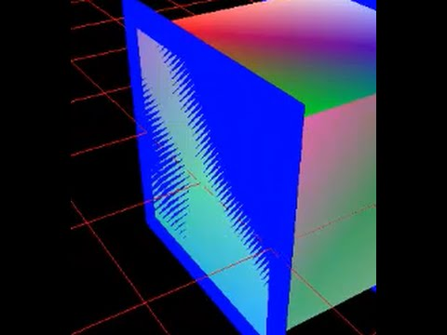
Obscure rule
When checking this rule, a scene is created where the given geometry is colored red, and the reference and mask are colored black. Images of this scene are rendered. You can now check the rendered images for red pixels. Any red pixel = illegal geometry.
If an infringement is found, then the color palette is altered slightly, and an image is saved that more clearly shows the infringement (see example next slide)
NB: This rule is sensitive to Z-fighting, so competitors should avoid making geometry that touches the reference volumes!
The obscure rule is quite versatile. It can be used to test a range of different rules. These include:
- Part-X must be fully contained within RV-Y
- From *angle* Part-X must obscure RS-Y
- Part-Y must be lowest part of the car within *area*
Common for all these rules is that if X is visible from a certain angle, then that indicates a breach of the rule.
Two different geometries must be specified:
“given_geometry” (X in the examples above)
“ref_geometry” (Y in the example above)
An additional ”mask” geometry can also be specified. The mask can help to specify the *area* in the example above
Z-fighting example →

Slide 6
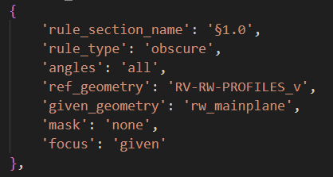
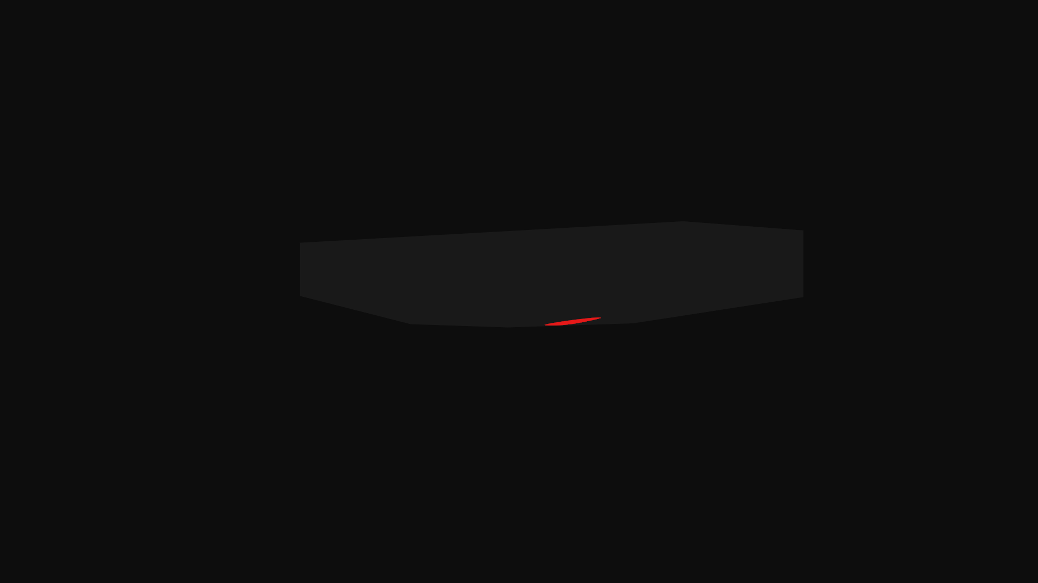
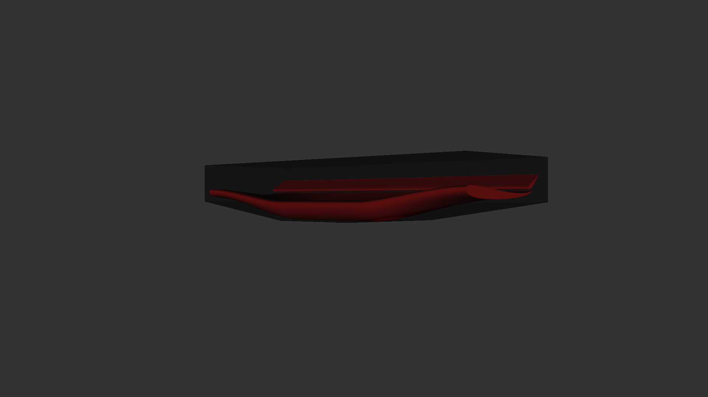
Obscure rule
The rule begin checked:
What the rule-checker sees:
(flat-coloring)
Rendered for more clarity:
(rendered with shadows)
Red = illegal
The bottom surface of the mainplane is not fully contained within the RV

Slide 7
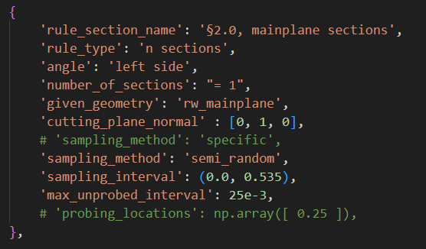
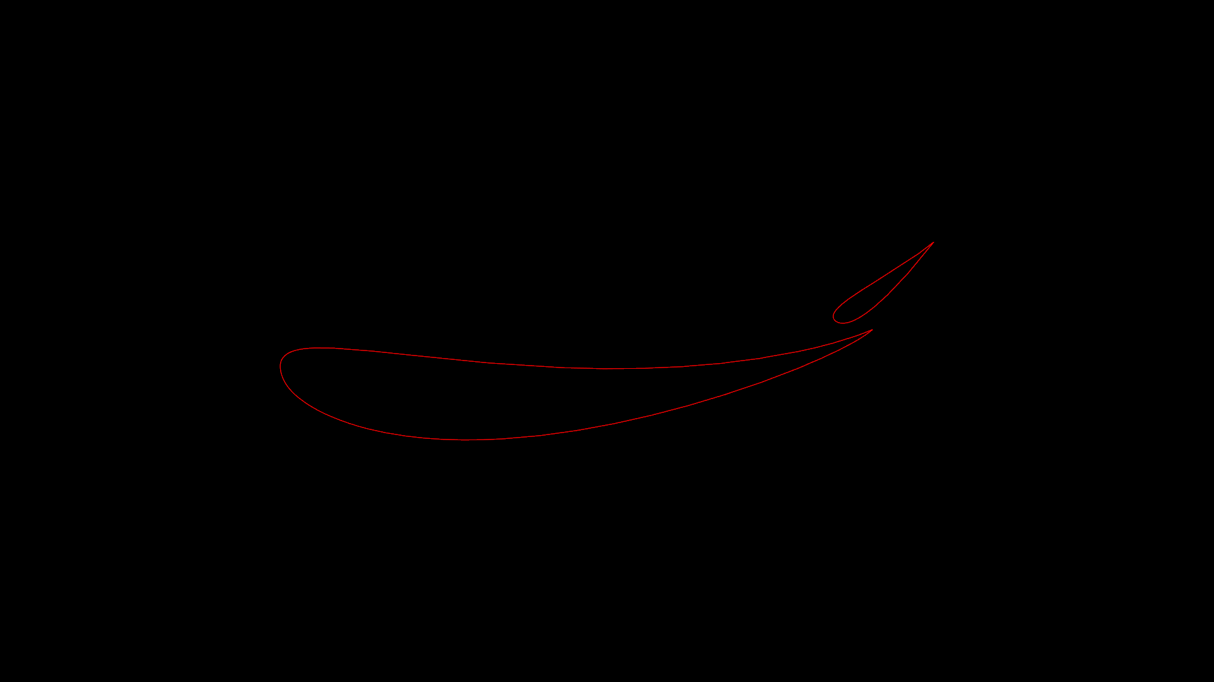
Number of sections
”Number of sections” –rule can be used to count number of sections in frontwings, rearwings etc.
It works by sectioning the geometry with a number of planes. The planes are defined with a normal vector, and an origin point.
The normal vector is specified in the rules.
for example (0, 1, 0) for y-sections.
The origin points can be defined either as a strict list of points, or as a ”semi-random” list of points in an interval. For semi-random sampling a ”maximum unprobed interval” must be defined, this is the maximum distance between planes.
The 3d coordinates of the origin points are found by multiplying each scalar in the list with the normal vector.
An image of the cut section is rendered. Then it counts the number of sections visible in the image. (see next slide)
NB! Since it only checks a limited number of sections, small infringements may or may not be caught!
Rendered image of a section:

Slide 8




Number of sections
The function counts the number of sections in the rendered image, with the following method:
Find a black pixel,
Bucket fill from this pixel
Add one to the counter
Repeat until image is all white
Rendered cut section
(red frame added for clarity)
”Bucket fill” with white from a corner
Convert to B/W
(8bit RGBa array)
(Boolean array)
Result: 2 sections
Why this way?
Another method could be to simply count the number of red sections. I decided against this approach because you often have overlapping geometries (because it is good for meshing). But you don't want to count any “internal” section as a section. This way you only count the number of sections in contact with the external flow. Imo this is closer to ideal.

Slide 9
Part 2
Mostly relevant to staff/contributors
This part should be irrelevant to competitors that don’t wish to contribute to the script.

Slide 10
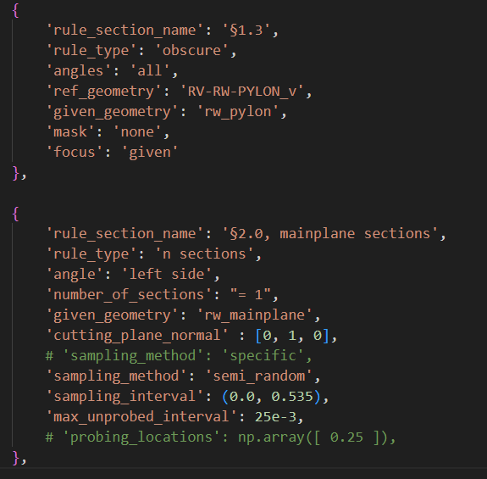
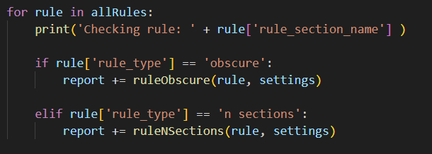
Rule definition
Two different rules in the rules list
All rules are gathered in a single list. This list is defined in rules.py
Each rule is defined as a dictionary
The rule-checker iterates through the list of rules. The keyword: ”rule_type” is important, this specifies which function is called.
All rules must return a string that is added to the report.
New rules can be added by simply defining a new function and adding this function to the if-statement in the scrutineer function.
From scrutineer function:

Slide 11
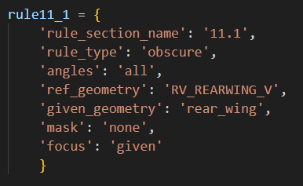
Obscure rule definition
Rule section name is used for the report
Angles, specifies the camera angles. Options include ”all”, ”above”, ”below” etc.
Ref_geometry colored black
Given geometry colored red
Mask colored black
Focus specifies the part to focus the camera on, here the given geometry. ½

Slide 12
Overview of generic VTK-pipeline
Source
Mapper
Interactor
Renderer
RenderWindow
Actor
Not used here

Slide 13
Overview of VTK-pipeline for Obscure rule
Read all stls in a given folder
Stl reader
Convert to vtkPolyData
Get Bounding Box coordinates
Define camera focus and location
Mapper
Render to numpy array
Renderer
RenderWindow
vtkAppend-PolyData
Actor
Stl reader
Convert to vtkPolyData
Stl reader
Convert to vtkPolyData
…

Slide 14
Overview of VTK-pipeline for N sections rule
Most likely room for improvement.
Get Bounding Box coordinates
Define camera focus and location
vtkAppend-PolyData
Mapper
Read all stls to find overall bounding box, for camera position
Stl reader
Convert to vtkPolyData
Stl reader
Convert to vtkPolyData
Stl reader
Convert to vtkPolyData
Stl reader
Cut with plane
Mapper
Actor
Read all stls cut them individually and add actor to renderer
Renderer
RenderWindow
Render to numpy array
Stl reader
Cut with plane
Mapper
Actor
Stl reader
Cut with plane
Mapper
Actor

